Slide 1
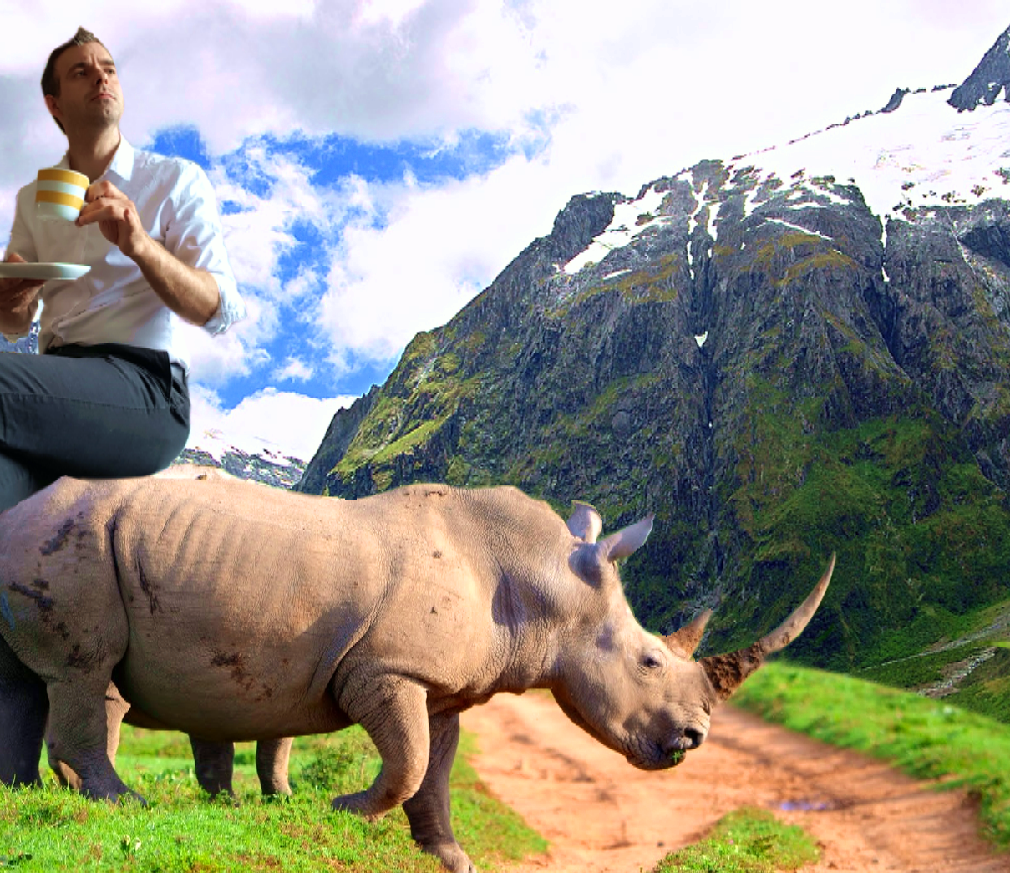
Jeroen Wintraecken productions
I say, lovely weather we’re having!
presents
A powerpoint about the present simple

Slide 2
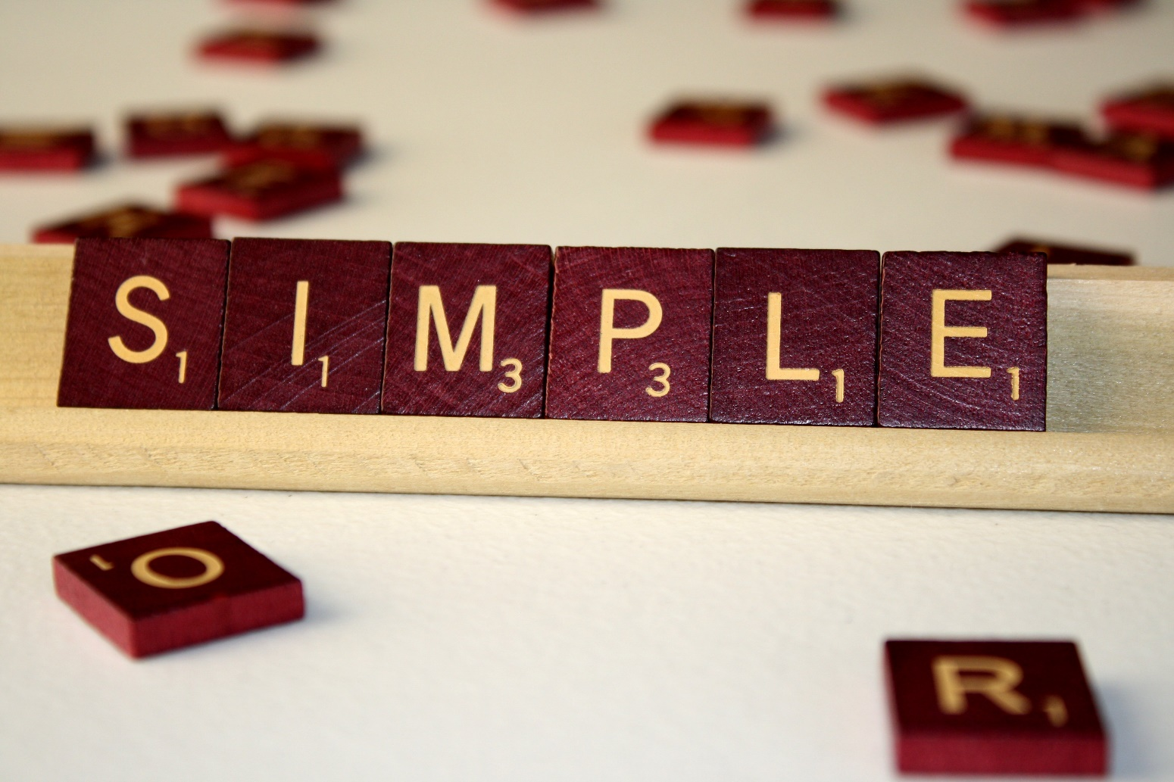
PRESENT SIMPLE

Slide 3
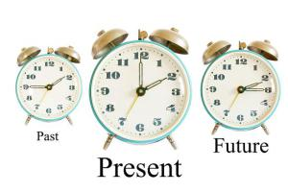
Present =
Simple: A B C D

Slide 4
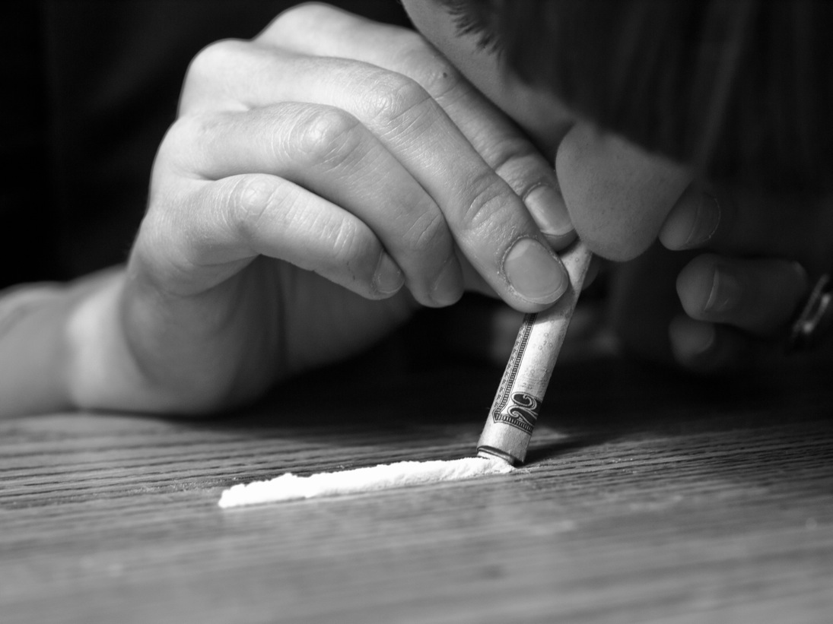
Present Simple gebruik
SNORT

Slide 5
Wanneer iets:
ALTIJD ZO IS → feiten en gewoontes
Peter likes soup!
Sara always goes by bus!
John likes apples!
John does not like apples!
Bij vaste vertrektijden van het OV en openingstijden van winkels:
The train leaves at 12 and the store opens at 5.

Slide 6
But how?!

Slide 7
Present simple: HOW?!
HELE WERKWOORD
HE, SHE, IT (SHIT): +S
We love soup
He loveS soup

Slide 8
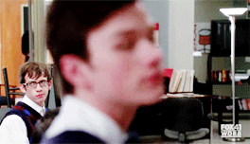
but wait! that’s not all!

Slide 9
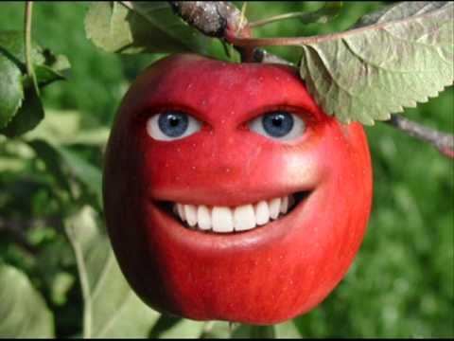
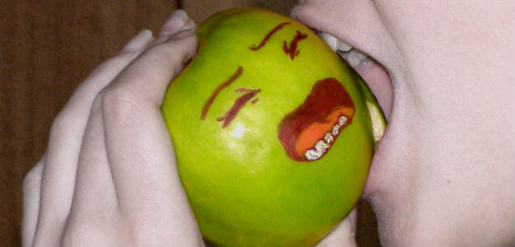
Negative V positive
I like apples
I do not like apples
BOTH ARE PRESENT SIMPLE!

Slide 10
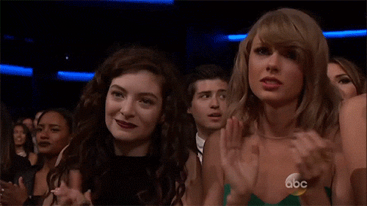
Now you can do the exercises!

